Slide 1
New Architecture
TA: 紀伯翰

Slide 2
Review

Slide 3
Review
Fully Connected Network
Convolutional Neural Network
Recurrent Neural Network

Slide 4
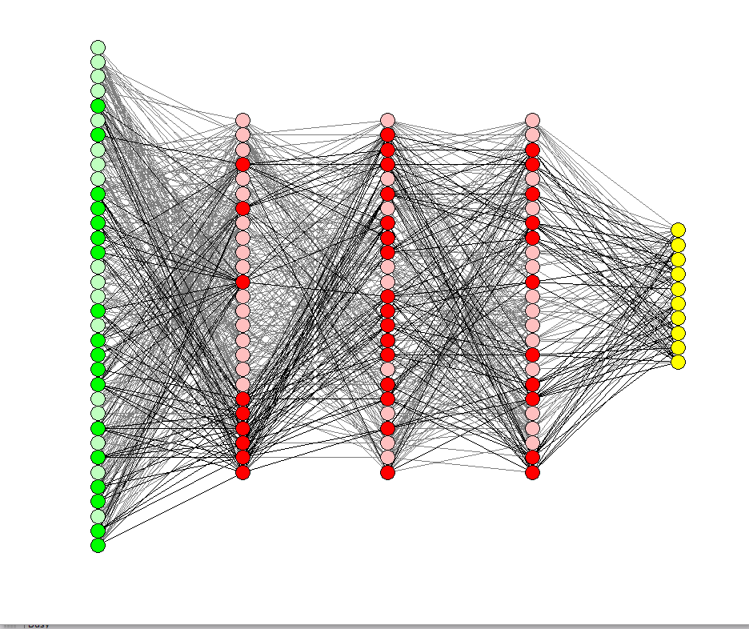
Basic Module - (1)
Fully Connected Network
Lots of Model ….

Slide 5

Basic Module - (2)
Convolutional Neural Network
ResNet
DenseNet
Inception Network

Slide 6

Basic Module - (3)
Recurrent Neural Network
Seq2seq
LSTM
Pointer Network ...

Slide 7

Stack them and hope the new model will be better !

Slide 8
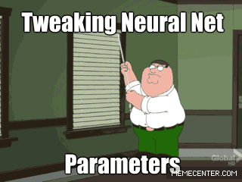

Slide 9


Slide 10


Slide 11


Slide 14

End

Slide 15
Follow up SOTA structure
Stable and explore faster

Slide 16
Why New Architecture ?
Increase Performance !
Extract better feature from data
Generalization
Reduce Parameters or explainable

Slide 17
Today’ s New Architecture
The variant structure design from the old module in 2019.
The cool application of architecture in 2019.
The SOTA models in the trend for 2019.

Slide 18
Outline
RNN less structure
Transformer
Sandwich transformers
Universal Transformer
Residual Shuffle Exchange Network
BERT
ALBERT, Reformer
StyleGAN

Slide 19
Transformer

Slide 20

Transformer - Encoding & Decoding

Slide 21
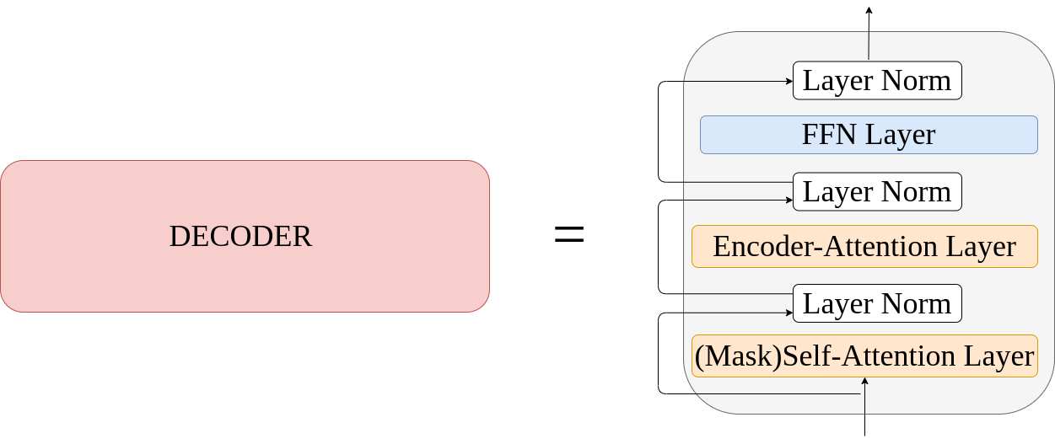
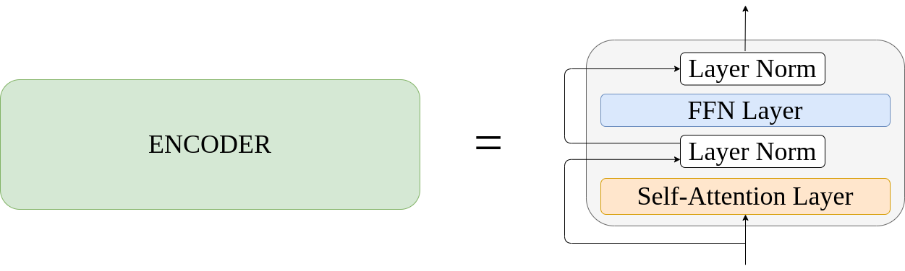
Transformer

Slide 22
Transformer - Encoding & Decoding

Slide 23

Transformer - Decoding

Slide 24
Sandwich Transformers

Slide 25
Motivation
Designing a Better Transformer

Slide 26
Reorder the sublayer ?
Could we increase the performance just by reorder the sublayer module ?

Slide 27
Highlight
models with more self-attention toward the bottom and more
feedforward sublayers toward the top tend to perform better in general.
No extra parameters, memory requirement.

Slide 28
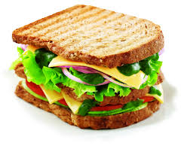
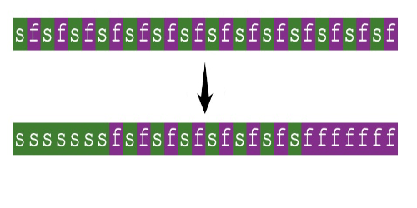
Sandwich transformer

Slide 29
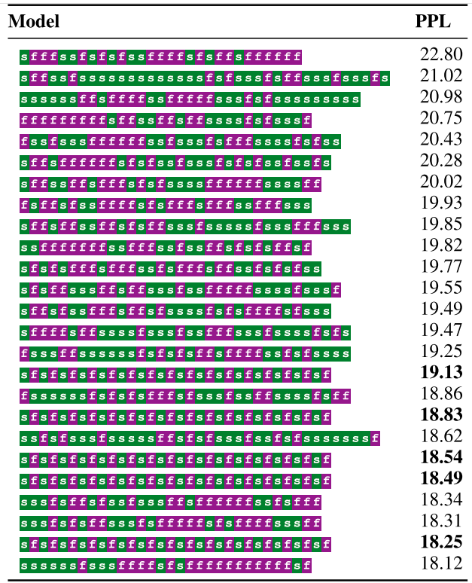
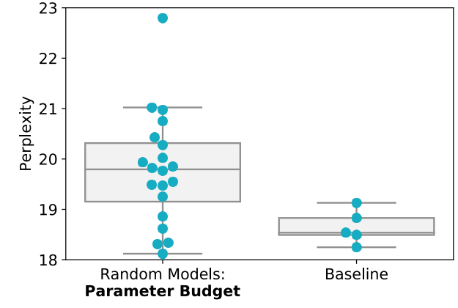
Same parameters but different order

Slide 30
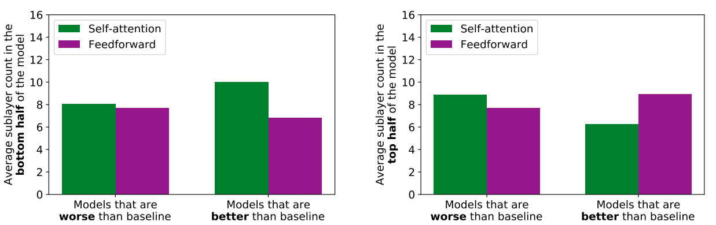
Are Balanced Architectures Better?

Slide 31
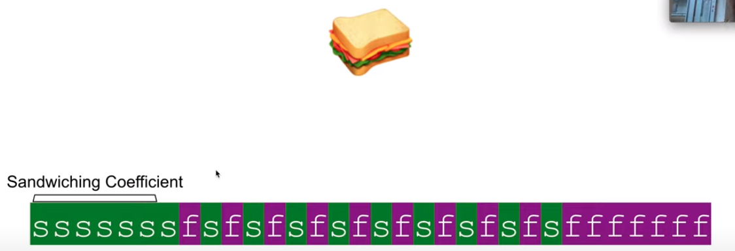
Sandwich Coefficient

Slide 32
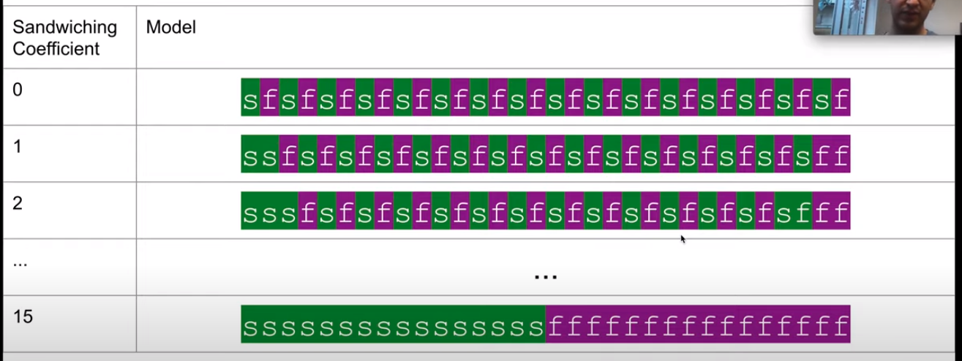

Slide 33
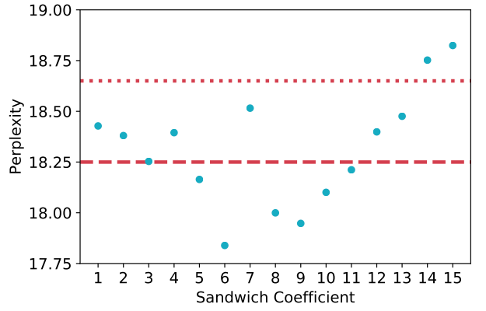

Slide 34
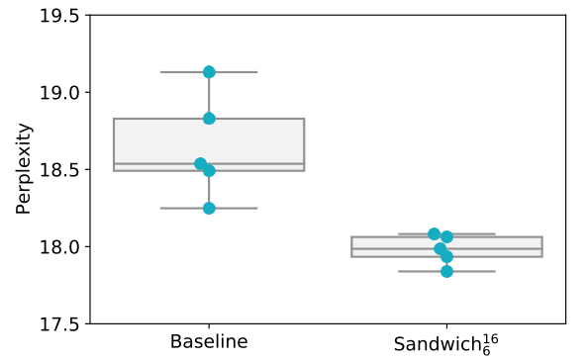
Experiment

Slide 35
Universal Transformer

Slide 36
Motivation
Transformer: Translation Good! / algorithmic task bad !
Neural GPU: Translation Bad! / algorithmic task Good!
Neural Turing Machine: Translation Bad! / algorithmic task Good!
Universal Transformer born !

Slide 37
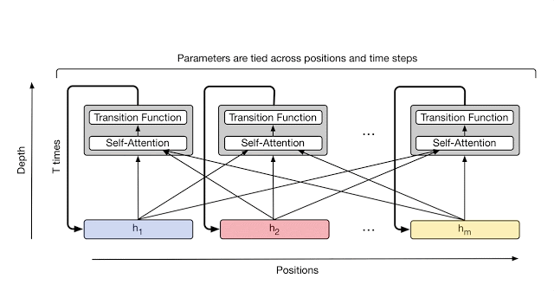
Universal Transformer

Slide 38
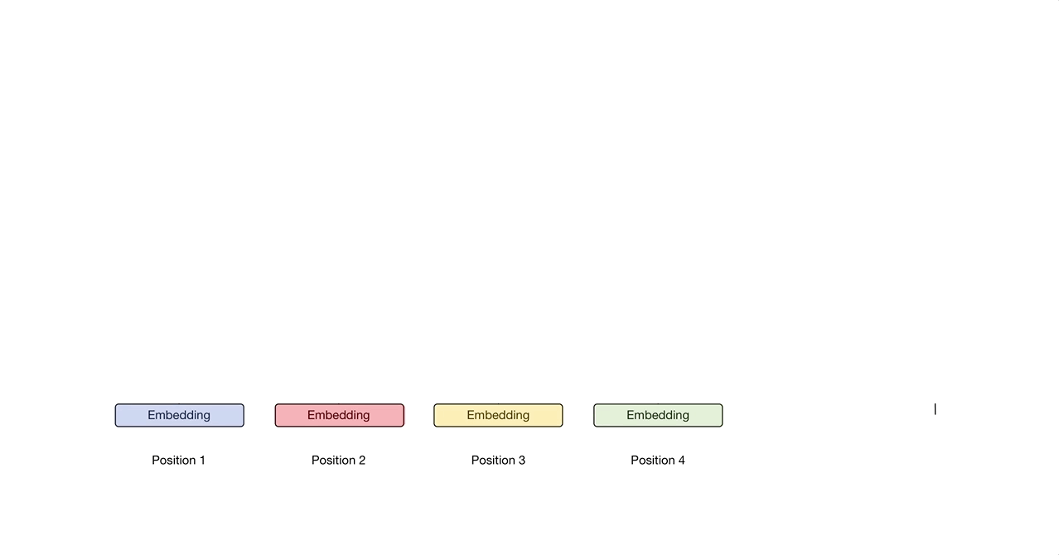
Dynamic Halting

Slide 39
Experiment(s)
Lambda Question Answering Dataset
WMT 14 En-De translation task

Slide 40
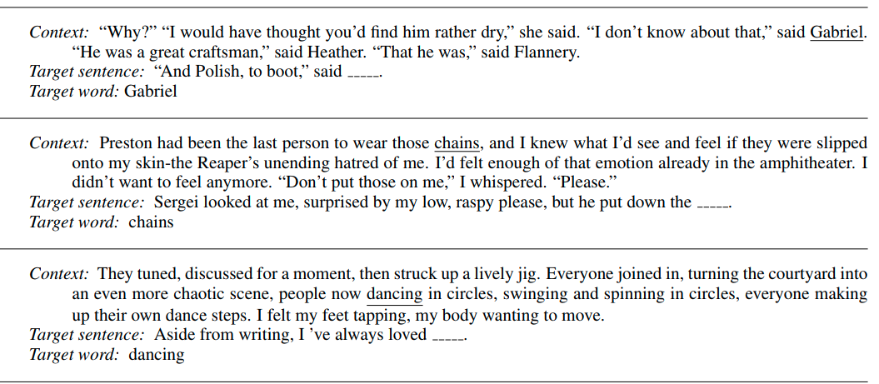
Lambda Question Answering Dataset

Slide 41
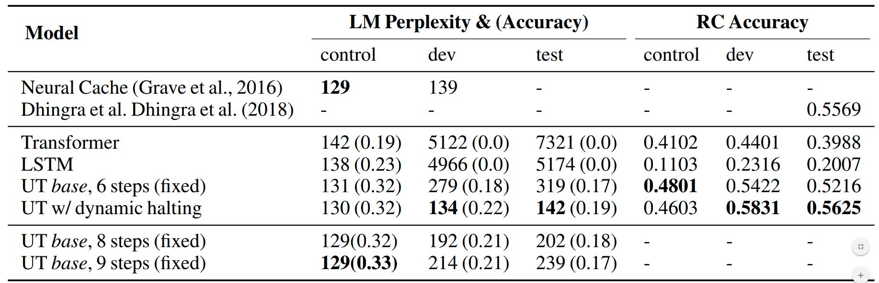
Result(s)

Slide 42
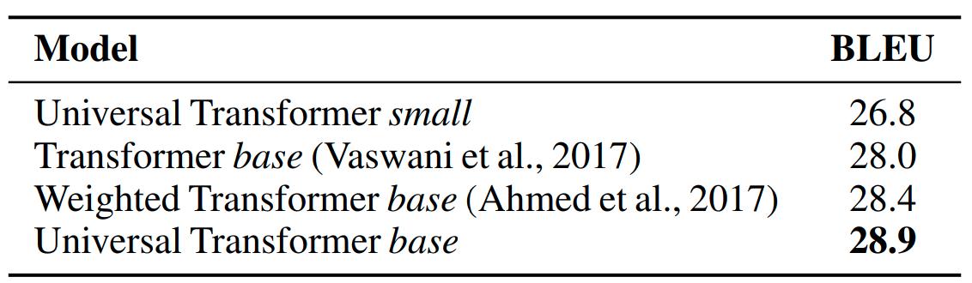
WMT 14 En-De translation task

Slide 43
Residual Shuffle Exchange Network

Slide 44
Residual Shuffle Exchange Network
HighLight:
Less parameters compare to other models for the same tasks.
Sequence processing in O(n log n) Time, specialize application on long sequence.
Shuffle & Exchange operators capture distant informations replace attention .

Slide 45
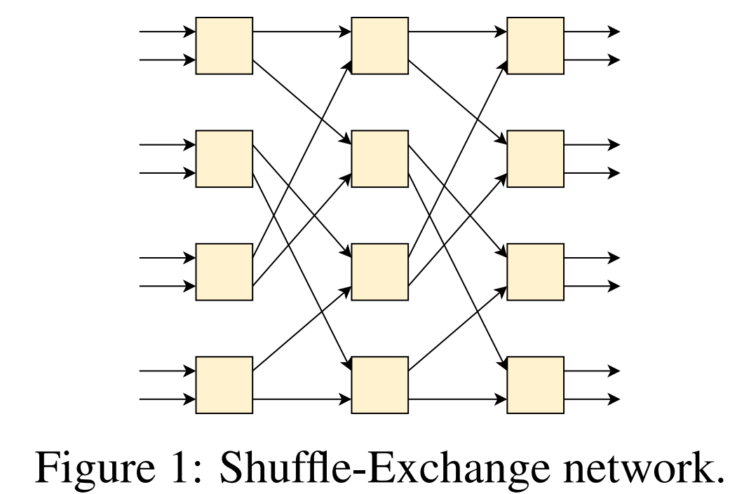
Shuffle-Exchange Network
Switch unit
Shuffle & Exchange
Where Shuffle ? Where Exchange ?

Slide 46
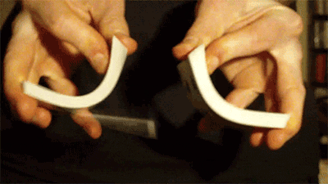
Shuffle, Exchange
Perfect shuffle:
1
2
3
4
1
2
3
4
5
6
7
8
1
5
2
6
3
7
4
8
5
6
7
8

Slide 47
1
2
3
4
1
2
3
4
5
6
7
8
1
5
2
6
3
7
4
8
5
6
7
8
????

Slide 48
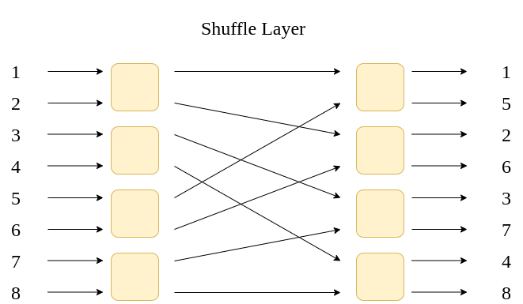
Shuffle

Slide 49
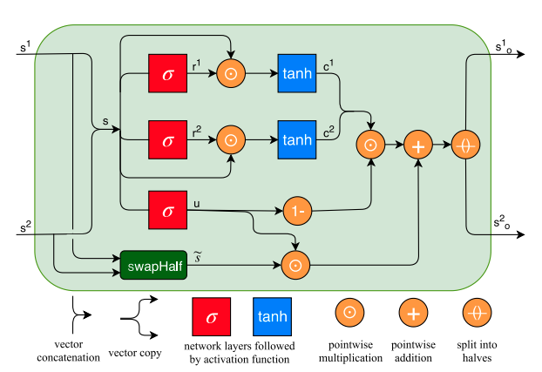
Neural Shuffle Exchange Network - Switch Unit

Slide 50
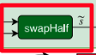
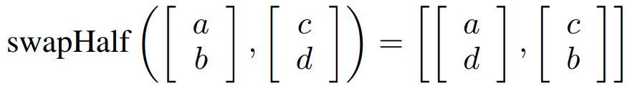
Exchange
s1
s2
s1
s2

Slide 51
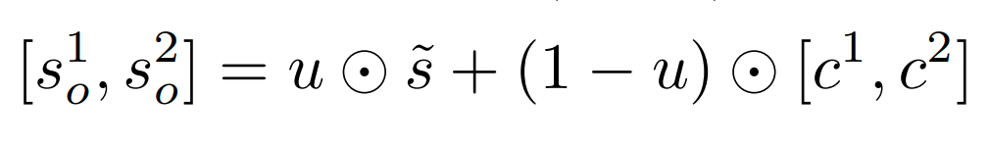
Neural Shuffle Exchange Network - Switch Unit
Determine
How Exchange

Slide 52
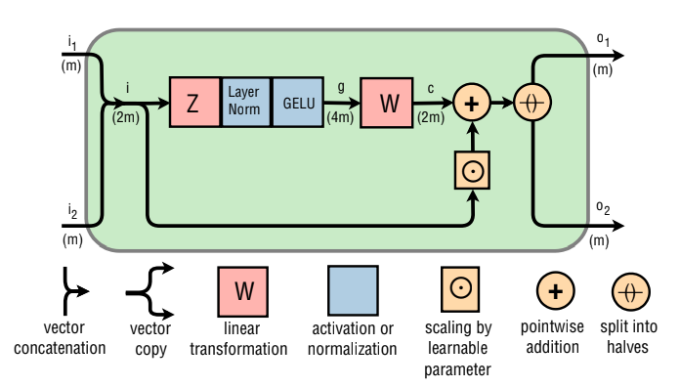
Residual Shuffle Exchange Network

Slide 53
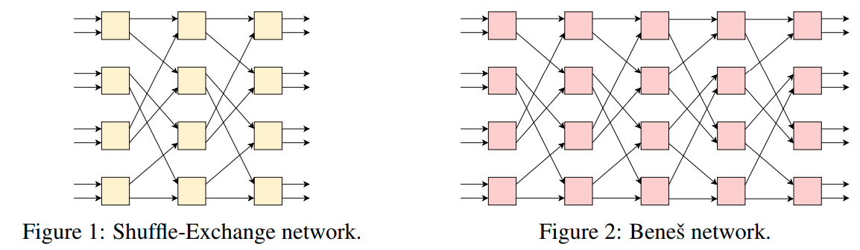
Shuffle-Exchange Network, Benes network

Slide 54
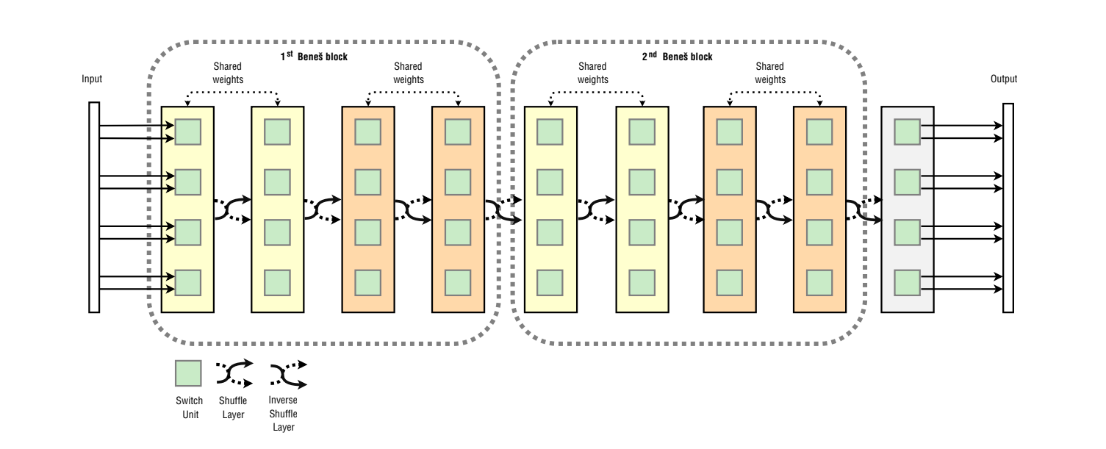
Residual Shuffle Exchange Network

Slide 55
Experiment(s)

Slide 56
5 Experiment Environments (mention 1)
Lambda Question Answering Dataset ✓
MusicNet Dataset
Multiplication Task
Sort Task
Adding Task

Slide 57
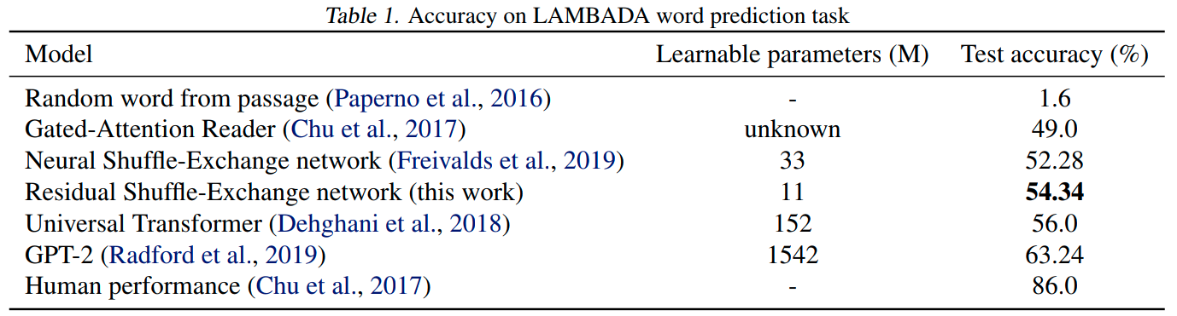
Experiment(s)

Slide 58
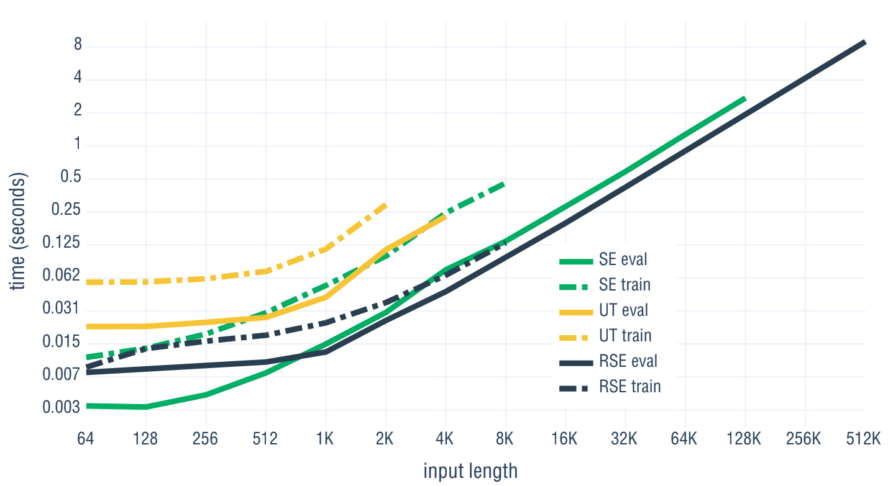
Experiment(s)

Slide 59
Memory Requirement
1. Evaluation: 11G GPU memory:
4x longer sequence than Neural Shuffle-Exchange Network.
128x longer sequence than Universal Transformer.

Slide 60
BERT

Slide 61

BERT

Slide 62
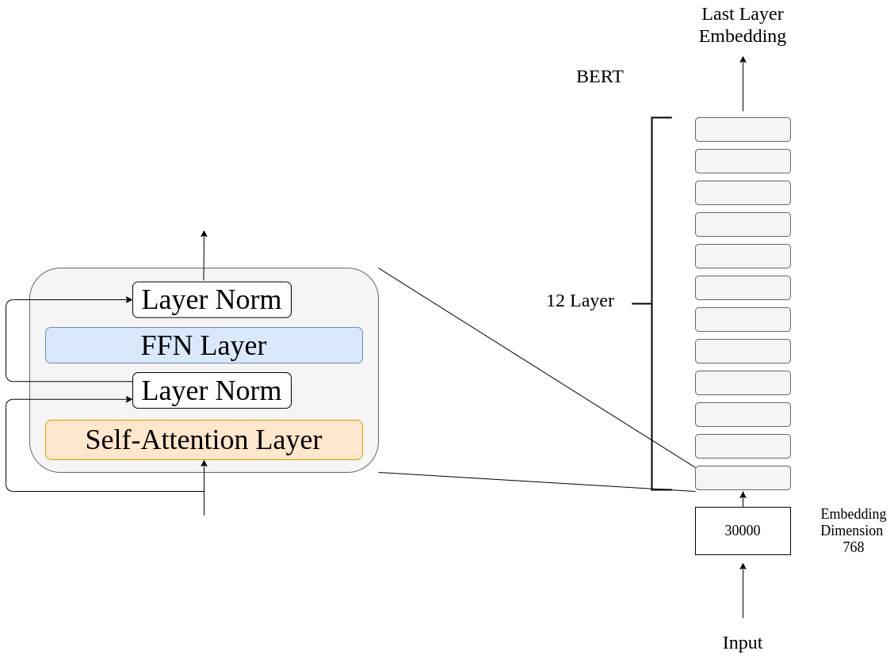
BERT

Slide 63
Bert: Pre-training Task
Mask Language Model:
Input: [CLS] 劉碩他要簽 [MASK] [CLS] 劉碩他要簽博
Next Sentence Prediction:
Input: ❌ [CLS] 我要當老師 [SEP] 人民的法槌
Input: ✔️ [CLS] 這隻手是人民的意志 [SEP] 人民的法槌

Slide 64
ALBERT

Slide 65
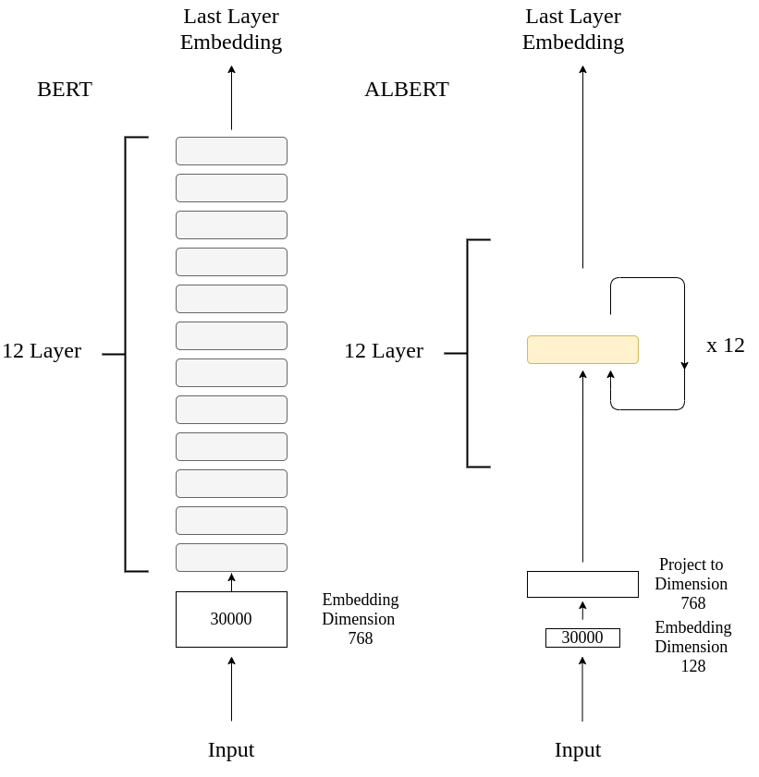
ALBERT

Slide 66
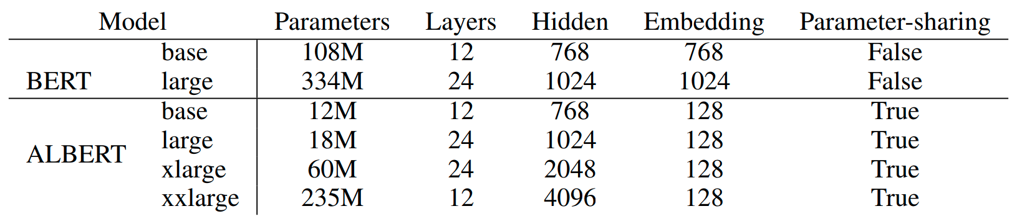
ALBERT

Slide 67
ALBERT
1.Factorize Embedding Matrix
Original BERT:
30000 x 768 = 23.04M
ALBERT:
30000 x128 = 3.8M
128 x 768 = 0.098M
Total: 3.898M
Reduce Parameters !

Slide 68
ALBERT
2.Shared Same Parameters across Layer
1/ 12 BERT Parameters
Reduce Parameters !!!

Slide 69
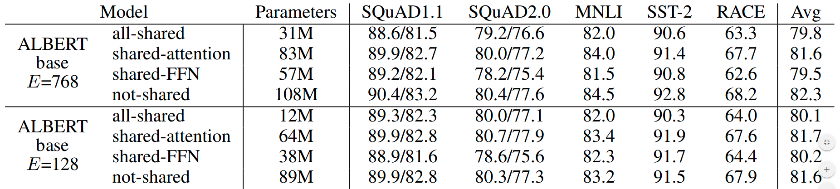
Share Parameters Experiment(s)

Slide 70
ALBERT: Pre-training Task
Mask Language Model:
Input: [CLS] 劉碩他要簽 [MASK] [CLS] 劉碩他要簽博
Sentence Order Prediction:
Input: ✖️ [CLS] 人民的法槌 [SEP] 這隻手是人民的意志
Input: ✔️ [CLS] 這隻手是人民的意志 [SEP] 人民的法槌

Slide 71
Reformer

Slide 72
BERT

Slide 73
Attention Layer

Slide 74
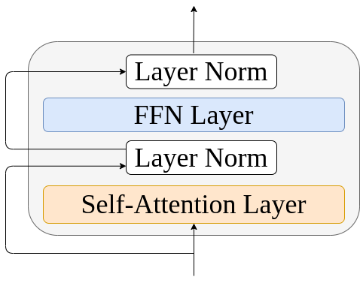
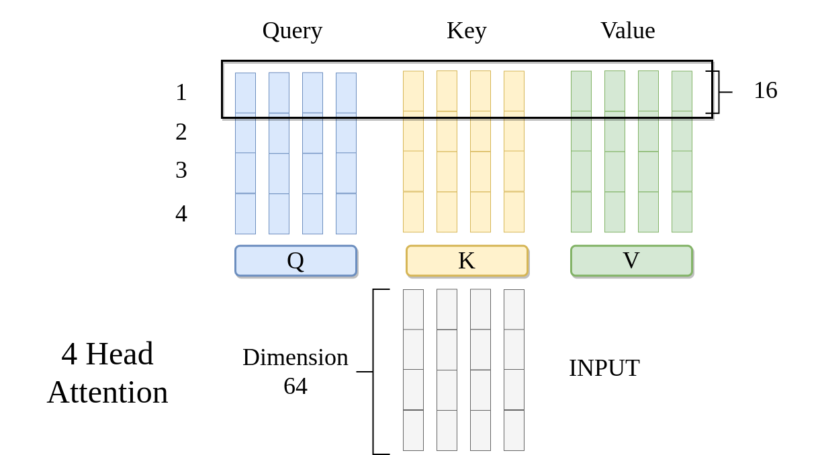
Attention Layer - Prepare Q, K, V

Slide 75
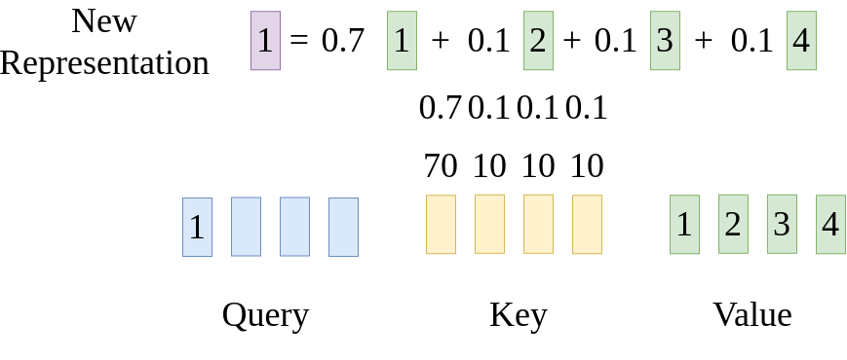
Attention Layer - Attention Mechanism
N = 4
Complexity: O(n²)

Slide 76
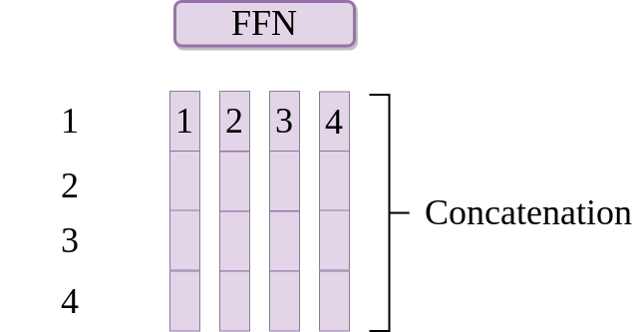
Concatenation - pass a FFN

Slide 77
Issue: Longer Sequence
Quadratic Perplexity: O(n²)
N larger Complexity high

Slide 78
Attention Layer - Attention Mechanism
N = 8k ?
Complexity: O(n²)

Slide 79
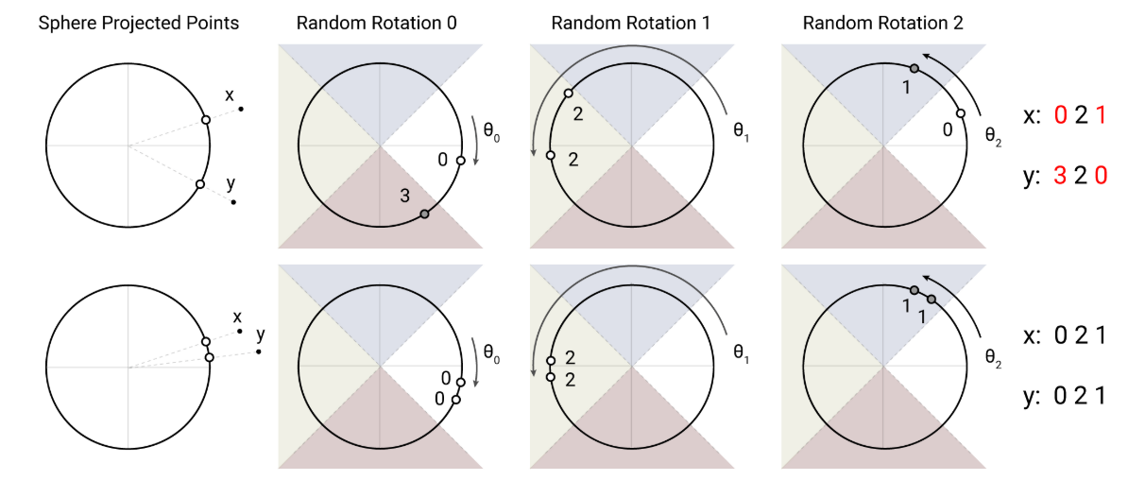
Hash Function

Slide 80
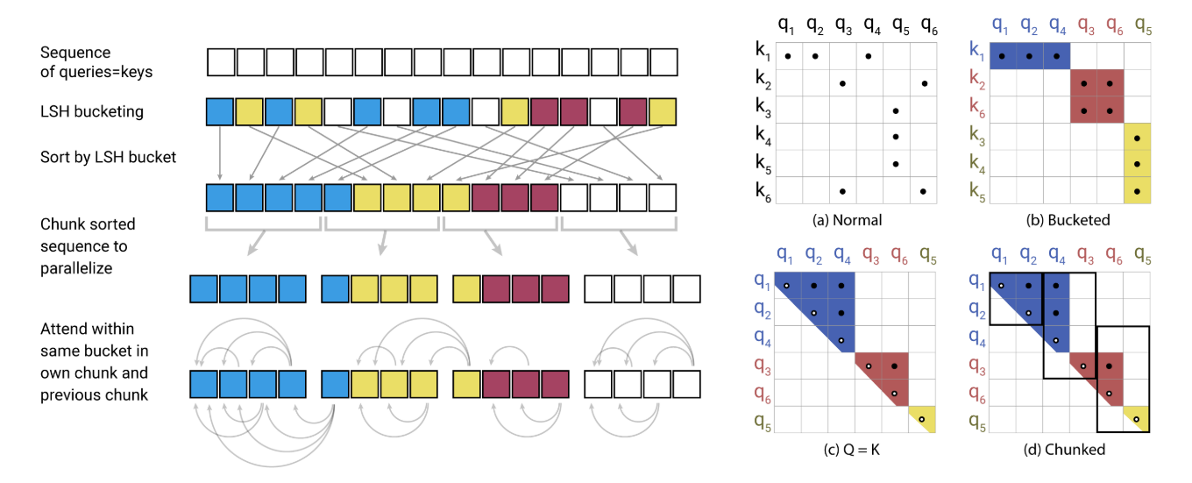
Reformer: Find a small set of candidates by hash function

Slide 81
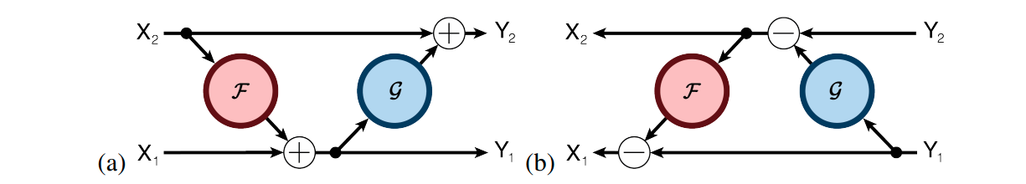
Reversible Layer

Slide 82
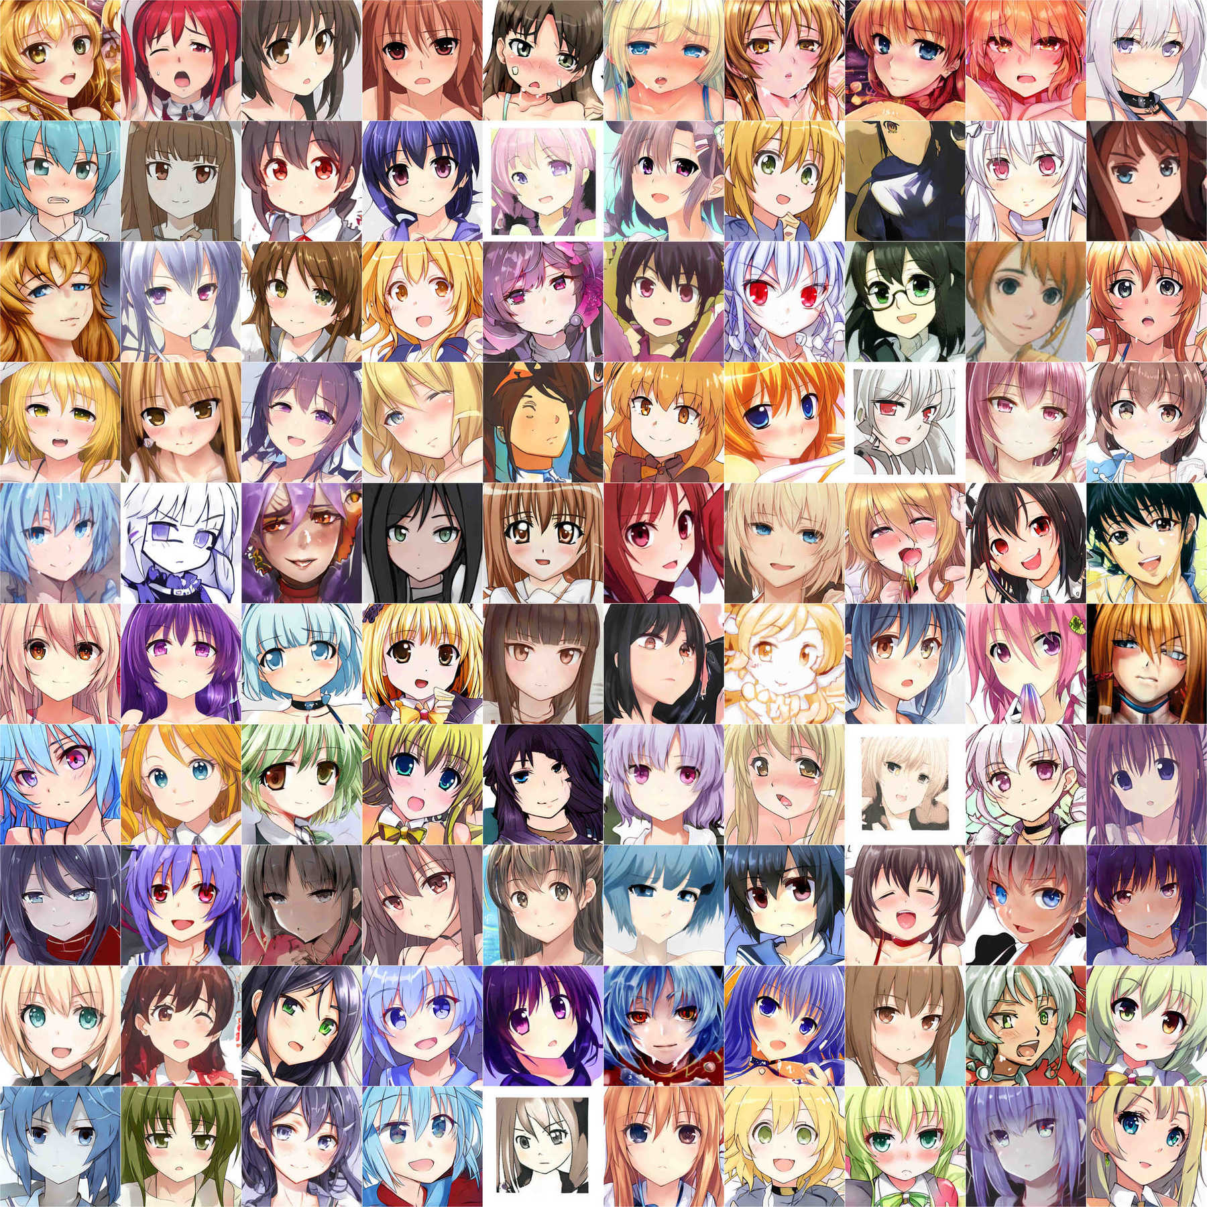
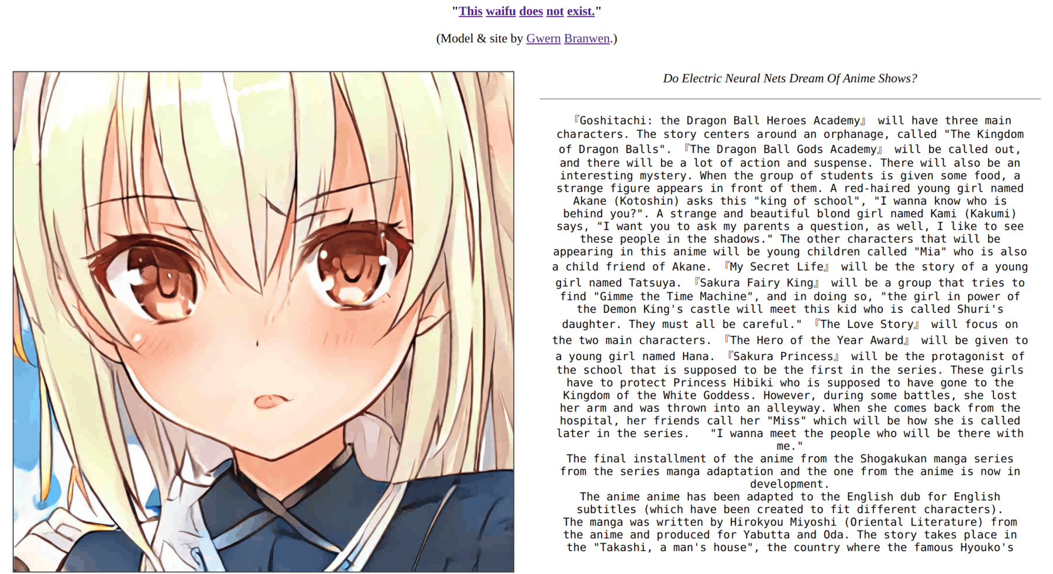
Style GAN
This Waifu Does Not Exist

